Slide 1
Паралелна обработка на информацията
Задание:
Създаване на многонишкова програма за сумирането на дължимите суми от фактури, намиращи се в голям файл, представляващ единствен ресурс
Десислава Милушева 471219007 Николай Каймакански 471219072
ИСН 3 курс 77 група

Slide 2
Съдържание:
Описание на заданието
Модел на паралелните изчисления
Имплементация на Java
Резултати

Slide 3
Описание на заданието
Да се създаде многонишкова програма за сумирането на дължимите суми от фактури, намиращи се в голям файл, представляващ единствен ресурс.
Резултатите от извършването на сумирането от всяка отделна нишка трябва да бъдат сумирани и изведени, след като всяка от нишките е завършила изпълнението си.

Slide 4
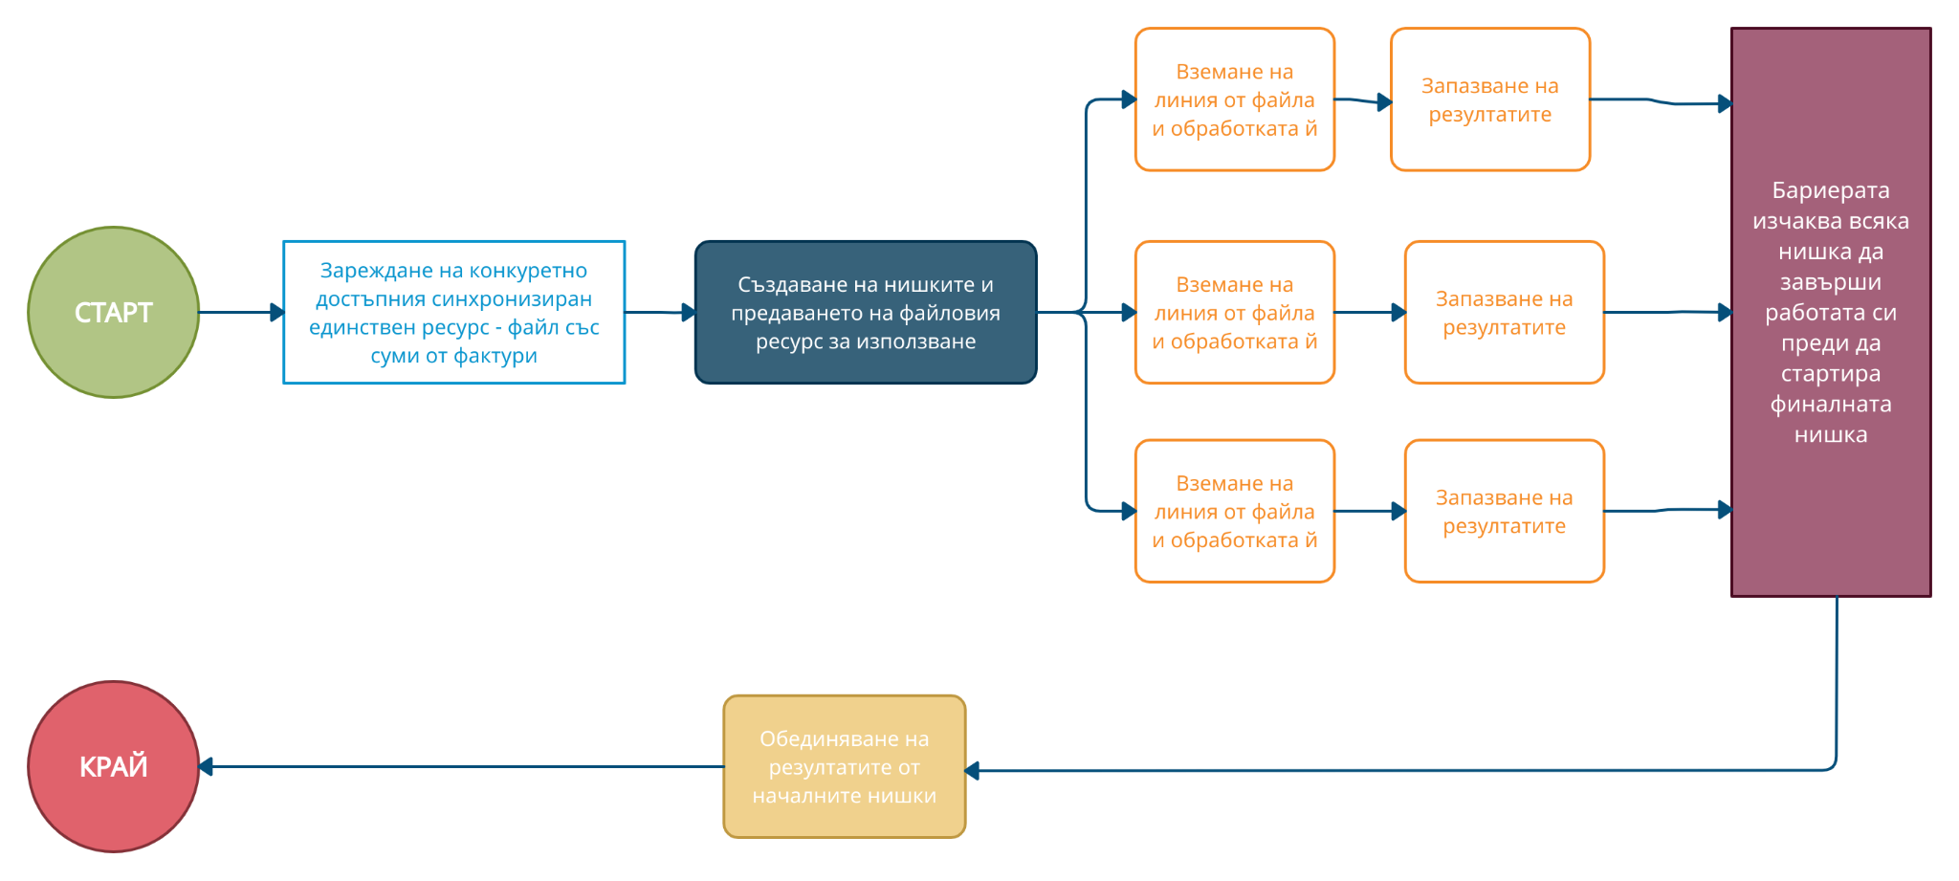
2. Модел на паралелните изчисления
Notes:
След стартиране на програмата и основната (main) нишка, първо се зарежда конкурентно достъпният файл, който е и единствен ресурс, а именно файлът със суми от фактури. Веднага след това се създават и останалите нишки (FileLineProcessingThreads), които ще работят върху файловия ресурс. Всяка нишка взема линия от файла и я обработва, като след това запазва резултата. Създадена бариера (CyclicBarrier) изчаква всяка от нишките (FileLineProcessingThreads) да завърши работата си. Накрая се стартира финална нишка (ResultFinalizationThread), която да обедини резултатите получени от всички нишки и да изведе реалният сбор от всички суми по фактури.

Slide 5
3. Имплементация на Java
https://github.com/desi109/invoices-sum-calculator---multithreading-java-app

Slide 6
public class InvoicesSumCalculatorMultithreading { private static final String FILE_PATH = new File(Paths.get(".").toString(), "resources/invoices.csv").getAbsolutePath(); private static final int NUM_THREADS = 3; private static CyclicBarrier barrier; private static List<Float> results = new ArrayList<>(NUM_THREADS); private static List<Thread> threads = new ArrayList<>(NUM_THREADS); public static void main(String[] args) { // 1. Start the program and the main thread try { // initialize a CyclicBarrier to wait for all FileLineProcessingThread to finish, before start the ResultConsolidationThread barrier = new CyclicBarrier(NUM_THREADS, new ResultFinalizationThread(results)); long beforeUsedMemory = Runtime.getRuntime().totalMemory() - Runtime.getRuntime().freeMemory(); // 2. Load and process the file invoices.csv CsvFileReader csvFileReader = new CsvFileReader(FILE_PATH); Watcher watcher = new Watcher(); watcher.startTimeNanos(); processPostsByLineMultithreading(csvFileReader); watcher.endTimeNanos(); long afterUsedMemory = Runtime.getRuntime().totalMemory() - Runtime.getRuntime().freeMemory(); System.out.println("Reading took: " + watcher.timeMillis() + " ms"); System.out.println("Memory used for the for the whole multithreading program: " + ((afterUsedMemory - beforeUsedMemory) / 1024.0) + " MB"); } catch (FileNotFoundException ex) { System.out.println(FILE_PATH + " does not exists!"); } } private static void processPostsByLineMultithreading(CsvFileReader csvFileReader) { for (int i = 1; i <= NUM_THREADS; ++i) { FileLineProcessingThread thread = new FileLineProcessingThread("Thread #" + i, csvFileReader, barrier, results); thread.start(); threads.add(thread); } } }

Slide 7
public class CsvFileReader implements AutoCloseable { private FileReader fr = null; private StringBuilder sb = new StringBuilder(); private int i; public CsvFileReader(String fileLocation) throws FileNotFoundException { fr = new FileReader(fileLocation); } public synchronized List<String> getCsvLine() throws IOException { sb.setLength(0); List<String> fileLine = new ArrayList<>(); // read every line, split its elements by comma, and put them iн fileLine ArrayList while ((i = fr.read()) != -1) { char c = (char) i; if (c == 10) { // 10 -> NEW LINE (\n) for (String element : sb.toString().split(",")) { fileLine.add(element); } sb.setLength(0); return fileLine; } else { sb.append(c); } } if (sb.length() != 0) { for (String element : sb.toString().split(",")) { fileLine.add(element); } sb.setLength(0); return fileLine; } return null; } @Override public void close() { } }

Slide 8
public class FileLineProcessingThread extends Thread { private String threadName; private CsvFileReader csvFileReader; private CyclicBarrier barrier; private List<Float> results; public FileLineProcessingThread(String threadName, CsvFileReader csvFileReader, CyclicBarrier barrier, List<Float> results) { this.threadName = threadName; this.csvFileReader = csvFileReader; this.barrier = barrier; this.results = results; } @Override public void run() { Watcher watcher = new Watcher(); watcher.startTimeNanos(); int fileLinesSize = 0; float sumOfAllInvoicesForCurrentThread = 0.0f; List<String> fileLine = new ArrayList<>(); try { fileLine = csvFileReader.getCsvLine(); while (fileLine != null) { ++fileLinesSize; // check if the sixth element is numeric (the invoice amount) if (isNumeric(fileLine.get(5))) { float invoiceAmount = Float.parseFloat(fileLine.get(5)); if (isNumeric(fileLine.get(4))){ float invoiceQuantity = Float.parseFloat(fileLine.get(4)); sumOfAllInvoicesForCurrentThread += invoiceAmount * invoiceQuantity; } else { sumOfAllInvoicesForCurrentThread += invoiceAmount; } //simulate more complicated computational work // Thread.sleep(1); } else { if (fileLine.size() < 5) { String lineContent = "["; int elementNumber = 0; for (String element : fileLine) { if ((fileLine.size() - 1) == elementNumber) { lineContent += element.trim() + "]"; } else { lineContent += element.trim() + ", "; } elementNumber++; }

Slide 9
System.out.println("Warning: inconsistent line: " + fileLinesSize + "! Content: " + lineContent); continue; } } fileLine = csvFileReader.getCsvLine(); } } catch (IOException e) { e.printStackTrace(); } results.add(sumOfAllInvoicesForCurrentThread); watcher.endTimeNanos(); System.out.println("Execution time of thread " + threadName + ": " + watcher.timeMillis() + " ms"); System.out.println("Sum of all invoices of thread " + threadName + ": " + sumOfAllInvoicesForCurrentThread); System.out.println("File lines size processed by thread " + threadName + ": " + fileLinesSize); try { // the CyclicBarrier will wait for all FileLineProcessingThread to finish, before start the ResultConsolidationThread barrier.await(); } catch (InterruptedException | BrokenBarrierException e) { e.printStackTrace(); } } private static boolean isNumeric(String strNum) { if (strNum == null) { return false; } try { float f = Float.parseFloat(strNum); } catch (NumberFormatException nfe) { return false; } return true; } }

Slide 10
public class ResultFinalizationThread extends Thread { private List<Float> results; public ResultFinalizationThread(List<Float> results) { this.results = results; } @Override public void run() { System.out.println("Result Finalization Thread started!"); float sum = 0.0f; for (Float result : results) { sum += result; } System.out.println("Invoices sum: " + sum); } } public class Watcher { private long startTime = -1; public void startTimeNanos() { this.startTime = System.nanoTime(); } public long endTimeNanos() { return System.nanoTime() - this.startTime; } public double timeMillis() { return this.endTimeNanos() / 1000000.0; } }

Slide 11
// InvoicesSumCalculatorSingleThreaded class public class InvoicesSumCalculatorSingleThreaded { private static final String FILE_PATH = new File(Paths.get(".").toString(), "resources/invoices.csv").getAbsolutePath(); public static void main(String[] args) { // 1. Start the program and the main thread try { long beforeUsedMemory = Runtime.getRuntime().totalMemory() - Runtime.getRuntime().freeMemory(); // 2. Load and process the file invoices.csv CsvFileReader csvFileReader = new CsvFileReader(FILE_PATH); Watcher watcher = new Watcher(); watcher.startTimeNanos(); processPostsByLineSingleThreaded(csvFileReader); watcher.endTimeNanos(); long afterUsedMemory = Runtime.getRuntime().totalMemory() - Runtime.getRuntime().freeMemory(); System.out.println("Reading took: " + watcher.timeMillis() + " ms"); System.out.println("Memory used from a single thread: " + ((afterUsedMemory - beforeUsedMemory) / 1024.0) + " MB"); } catch (FileNotFoundException ex) { System.out.println(FILE_PATH + " does not exists!"); } } private static void processPostsByLineSingleThreaded(CsvFileReader csvFileReader) { Watcher watcher = new Watcher(); watcher.startTimeNanos(); int fileLinesSize = 0; float sumOfAllInvoicesForCurrentThread = 0.0f; List<String> fileLine = new ArrayList<>(); try { fileLine = csvFileReader.getCsvLine(); while (fileLine != null) { ++fileLinesSize; // check if the sixth element is numeric (the invoice amount) if (isNumeric(fileLine.get(5))) { float invoiceAmount = Float.parseFloat(fileLine.get(5)); if (isNumeric(fileLine.get(4))) { float invoiceQuantity = Float.parseFloat(fileLine.get(4)); sumOfAllInvoicesForCurrentThread += invoiceAmount * invoiceQuantity; } else {

Slide 12
sumOfAllInvoicesForCurrentThread += invoiceAmount; } //simulate more complicated computational work // Thread.sleep(1); } else { if (fileLine.size() < 5) { String lineContent = "["; int elementNumber = 0; for (String element : fileLine) { if ((fileLine.size() - 1) == elementNumber) { lineContent += element.trim() + "]"; } else { lineContent += element.trim() + ", "; } elementNumber++; } System.out.println("Warning: inconsistent line: " + fileLinesSize + "! Content: " + lineContent); continue; } } fileLine = csvFileReader.getCsvLine(); } } catch (IOException e) { e.printStackTrace(); } watcher.endTimeNanos(); System.out.println("Execution time for a single thread: " + watcher.timeMillis() + " ms"); System.out.println("File lines size processed by a single thread: " + fileLinesSize); System.out.println("Invoices sum: " + sumOfAllInvoicesForCurrentThread); } private static boolean isNumeric(String strNum) { if (strNum == null) { return false; } try { float f = Float.parseFloat(strNum); } catch (NumberFormatException nfe) { return false; } return true; } }

Slide 13
4. Резултати
1 thread - InvoicesSumCalculatorSingleThreaded.java ----------------------------------------------------- Execution time for a single thread: 12146.699535 ms File lines size processed by a single thread: 10000 Invoices sum: 2656788.2 Reading took: 12176.839503 ms Memory used from a single thread: 43302.390625 MB
4 threads - InvoicesSumCalculatorMultithreading.java ------------------------------------------------------ Reading took: 16.212648 ms Memory used for the for the whole multithreading program: 1064.890625 MB Execution time of thread Thread #1: 2932.733991 ms Execution time of thread Thread #3: 2931.733848 ms Execution time of thread Thread #4: 2931.502864 ms Execution time of thread Thread #2: 2932.124885 ms Sum of all invoices of thread Thread #1: 661921.8 Sum of all invoices of thread Thread #2: 662503.7 Sum of all invoices of thread Thread #4: 663492.1 Sum of all invoices of thread Thread #3: 668875.1 File lines size processed by thread Thread #3: 2500 File lines size processed by thread Thread #2: 2501 File lines size processed by thread Thread #1: 2500 File lines size processed by thread Thread #4: 2499 Result Finalization Thread started! Invoices sum: 2656788.2

Slide 14
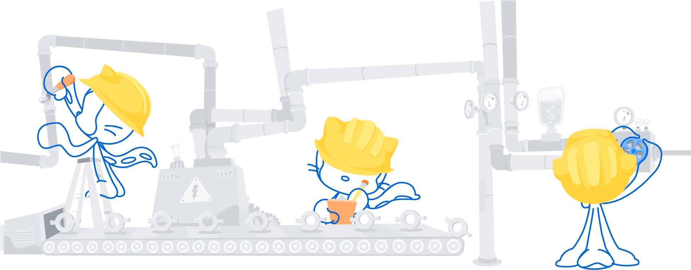
Благодаря за вниманието!

